Slide 1



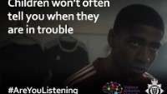
Keeping Young People Safe in BCP
Following a survey on youth safety in the community, we asked parents, carers, and young people about their views via an online survey and discussion groups at three schools in the BCP area. We received a high level of engagement from 267 parents and carers as well as 210 young people in Years 9 and 10.
This briefing will summarise the key findings of the surveys and an overview about county lines, recognising the signs and where you can seek further support and information.
How parents and carers feel local services could help….
  Police and Community Officers’ presence, particularly in specific areas, parks, and open areas
  More information, advice and guidance for young people in and outside of school
  Workshops/information for parents/carers on spotting the signs of criminal exploitation and how to seek help
  Increase youth workers, youth centres, activities to engage young people. Provide more mentoring and advice from those who have been involved and managed to get out.
We are continuing to work hard to protect young people from criminal exploitation. Local agencies are actively disrupting unsafe activities via Police, Children’s Social Care and Community Safety Wardens. It’s important for parents and carers to also remain vigilant about the signs of criminal exploitation and seek support or advice if they have any concerns.
Police encourage information to be shared with them that a young person may have disclosed, you have witnessed or are concerned about. Reporting information about criminal activity is key in building cases and convicting adults who exploit young people to be involved in crime. Crimestoppers is another way to report information anonymously. They are an independent charity and not linked to police. Crimestoppers

Slide 2

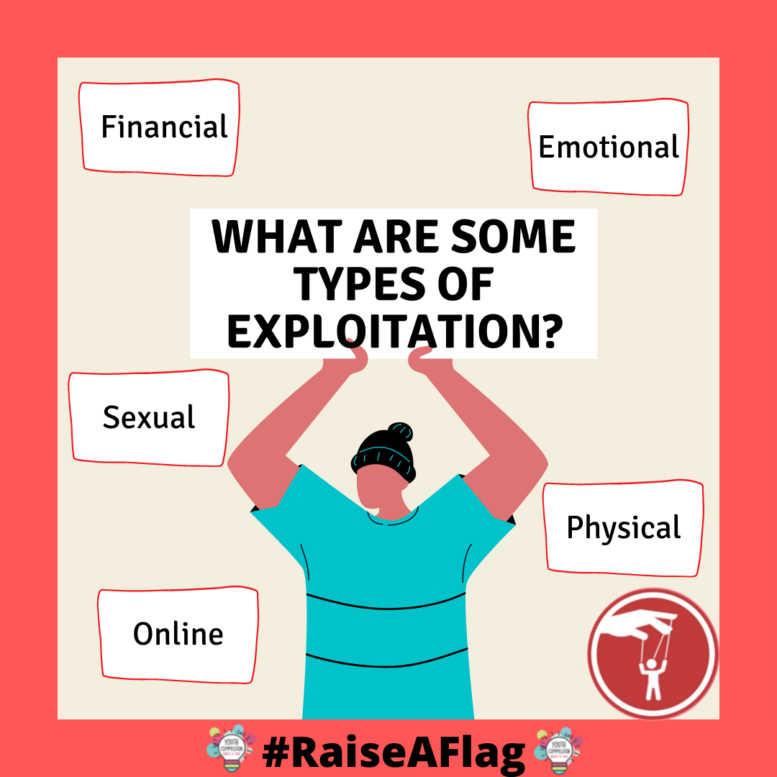
Young people in Years 9 and 10 were offered the opportunity to share their views via an online survey available at three local secondary schools. There were 210 responses in total and below is a summary of their voices….
The key findings from the survey showed that young people are most concerned about being a victim of crime, local gangs and being bullied. On the opposite end, young people felt least concerned about travelling to and from school and being pressured to join gangs. The majority of young people said they felt safe in the area they lived in during the day but felt less safe during the evening. To support with this, they said more CCTV in parks and public places, more uniformed police officers and fewer drug dealers would help them feel safer in the area they live. Just over half the young people asked knew how to report a non urgent crime to police and make a report, this shows that young people would benefit from education on how to report something and what support is available if they have any concerns. ‘Fearless’ offers advice to young people about crimes that may have affected them and maintains their anonymity. It’s part of Crimestoppers Fearless

Slide 3
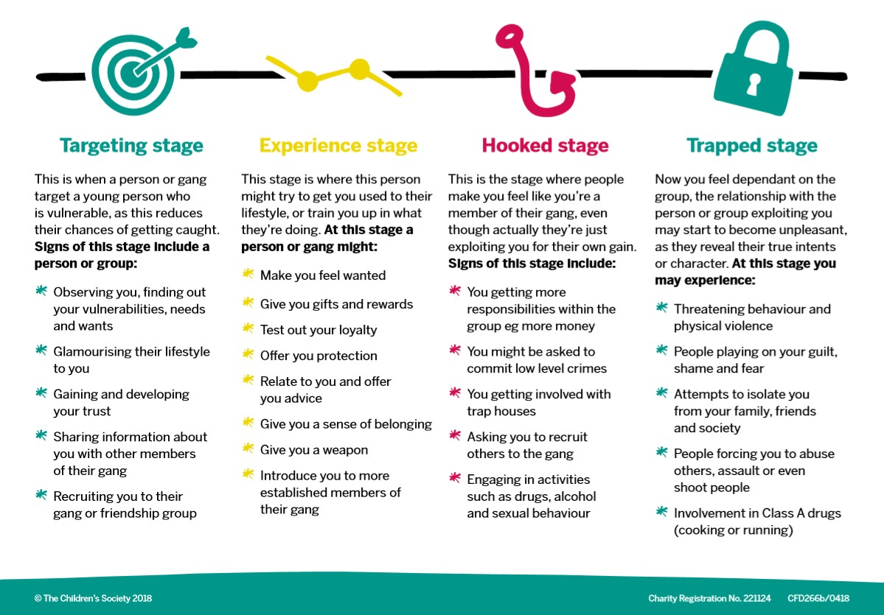
What is county lines?
County line gangs use young people to prepare, store, deliver and sell drugs around the country or within the local communities by using coercion, intimidation, debt bondage (creating a debt the child has to pay back), violence and/or grooming. Gangs use children because they are cheaper, more easily controlled and less likely to get picked up by police. Children exploited by county lines can be sent to different towns/counties to carry out tasks for the gangs. County line groups tend to use younger members to identify and target other young people either through personal or social media links. There are four stages of young people being recruited by exploiters for county lines:
What are the risks to young people?
  Young people may have to travel long distances to places they do not know, visiting or staying at unsafe properties to deliver and/or sell drugs and return the proceeds of the sale.
  Exploiters are known to stage “muggings” where young people are robbed of these drugs or money and can be subsequently punished through violence; this is to instil fear and create a debt to the exploiter. Threats and violence to control young people is a major feature of county lines exploitation.
  Many young people who are being exploited through involvement in county lines will carry knives and weapons for protection, raising the risk of serious injury.
  Not all drug related activity is linked to county lines, however, the risks to young people is similar including violence, coercion, going missing, trafficking of young people to other areas, sexual exploitation, and anti-social behaviour.
Spotting the signs
  Are they frequently going missing from school or home?
  Are they travelling alone to places far away from home?
  Do they suddenly have lots of money/new clothes/new mobile phones?
  Are they receiving a lot more calls or texts than usual?
  Are they carrying or selling drugs?
  Are they carrying weapons or know people that have access to weapons?
  Are they in a relationship with or spending time with someone/people that are older and controlling?
  Do they have unexplained injuries?
  Do they seem like they have something to hide?
  Do they seem scared?
Information and
Support
  BCP Family Information Directory
  PACE
  Escape Line
  Dorset Police
  Pan-Dorset Safeguarding Children Partnership
  StreetSafe Tool - The government is trialling a new online tool which lets members of the public anonymously pinpoint on a map locations where they don’t feel safe.

