Slide 1
Speed sounds
24.11.20
Mrs Semple will say the sound you repeat!

Slide 2
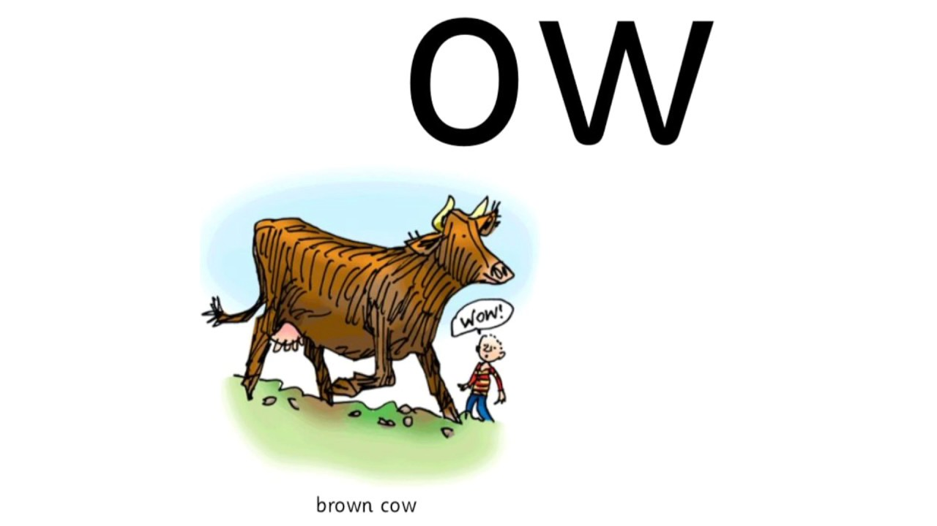

Slide 3
ow – now lets read some words with the ow sound in them
Remember I will Fred talk them and then you Fred talk and then say the word.
now
cow
town
down
brown

Slide 4
ow- This time Fred in your head and then say the word
now
cow
town
down
brown

Slide 5
Now lets read them a bit quicker!
READY….

Slide 6
now

Slide 7
cow

Slide 8
down

Slide 9
brown

Slide 10
town

Slide 11
Now you are going to write some of the words.
Write the word….- remember fred in your head!
Ready?
now
Tick or fix

Slide 12
Write the word….- remember fred in your head!
Ready?
town
Tick or fix

Slide 13
Write the word….- remember fred in your head!
Ready?
brown
Tick or fix

Slide 14
Well done everyone!
Now we are going to learn a red word spelling!
they

Slide 15
How many times can you write the word they in one minute?

