Slide 2
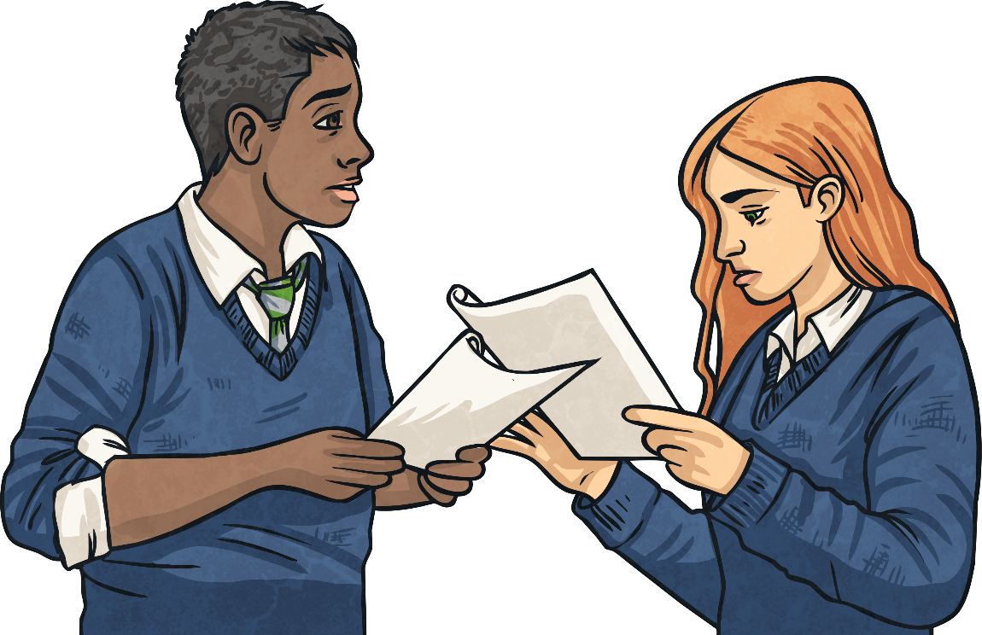
Writing a Diary Entry
When you write a diary entry, you are writing about a day in the life of a real person or character. The diary entry needs to sound as if the person or character has written it so it needs to be written from their point of view. It also needs to be exciting and interesting to read. To get this right, just follow a few easy steps...

Slide 3
Diary Writing Must…
include the date and/or time
The date or time can be written at the top of the page like this...
6th July 1980
Dear Diary,
Today, I made an upsetting announcement which could affect the whole world – the number of bees is declining. Following a lifetime of interest in bees, my recent discoveries have saddened me greatly. We need to so something about this.
…or it can be included in the first few sentences of a diary entry like this...
Today, I proved my intelligence even though I only received a simple education, when I fought for the right to put my name to my invention. Early this morning, I arrived at the courtroom to face the man who was determined to steal my ideas.
Today, I proved my intelligence even though I only received a simple education, when I fought for the right to put my name to my invention. Early this morning, I arrived at the courtroom to face the man who was determined to steal my ideas.

Slide 4
Diary Writing Must…
be written in the first person.
This means including pronouns such as ‘I’, ‘my’, ‘we’ and ‘our’.
These words are special because they tell us the diary is being written by someone and they are talking about themselves.
Look at the next two examples. Which one uses the correct words to be written in the ‘first person’?
This means including pronouns such as ‘I’, ‘my’, ‘we’ and ‘our’.
These words are special because they tell us the diary is being written by someone and they are talking about themselves.
Look at the next two examples. Which one uses the correct words to be written in the ‘first person’?

Slide 5
Diary Writing Must…
be written in the first person.
As I have travelled to many different countries, I have discovered so many new facts about bees and shared these.
As she has travelled to many different countries, she has discovered so many new facts about bees and shared these.
As I have travelled to many different countries, I have discovered so many new facts about bees and shared these.
As she has travelled to many different countries, she has discovered so many new facts about bees and shared these.
First person
Not first person

Slide 6
Diary Writing Must…
tell events in chronological order.
In a diary we usually write about the events of our day in the order they happened.
We only include the most important or interesting events.
Which of these events would you include in a diary?
I ate breakfast.
We boarded the largest ship in the dock.
The seas were choppy as we left the harbour.
We had to wear lifejackets to keep us safe.
I looked at the water.
You might choose to include information about breakfast and looking at the water if it is relevant or unusual.

Slide 7
Diary Writing Must…
describe the events from the writer’s point of view.
A diary is a personal recount usually about a specific event.
The writer will give their own ideas and opinions about the subject.
They will use first person point of view language, such as ‘I think…’, ‘I believe…’
Where does this writer give their point of view?
A diary is a personal recount usually about a specific event.
The writer will give their own ideas and opinions about the subject.
They will use first person point of view language, such as ‘I think…’, ‘I believe…’
Where does this writer give their point of view?
Following nearly a lifetime of interest in bees, my recent discoveries have saddened me greatly. We need to do something about this.
Following nearly a lifetime of interest in bees, my recent discoveries have saddened me greatly. We need to do something about this.

Slide 8
Diary Writing Must…
include personal emotions and feelings.
A diary is usually a secret place to write the truth about how you feel about what has happened to you in the day.
In a diary you might include feelings, hopes or fears that you wouldn’t want anyone to know about.
Look at the examples below. Where have these diary writers described their feelings?
My anxiety lifted as the judge proclaimed that Charles Annan had obviously stolen my blueprint and the right to patent the design remains with me.
On my many travels, I have been lucky enough to discover so many new facts about bees and share these with the world in my books.
My anxiety lifted as the judge proclaimed that Charles Annan had obviously stolen my blueprint and the right to patent the design remains with me.
On my many travels, I have been lucky enough to discover so many new facts about bees and share these with the world in my books.

Slide 9
Diary Writing Must…
use paragraphs to organise writing (including an introduction and conclusion).
A diary is usually a secret place to write the truth about how you feel about what has happened to you in the day.
In a diary you might include feelings, hopes or fears that you wouldn’t want anyone to know about.
Look at the examples below. Where have these diary writers described their feelings?
When?
What?
Today I received the best news – the expedition that I have been planning for years is to happen thanks to the new rulers of Spain.
Today
the expedition
new rulers of Spain.
Who?
A conclusion can be a sentence that sums up how the writer is feeling, such as:
Whatever happens, I will have explored the seas to find new worlds.

Slide 10
Diary Writing Must…
use an informal style.
Diaries are usually written for our own eyes so they are not usually written in a formal style.
If we are writing a diary from the perspective of someone else, it is important to remember the language they might use due to their age, era or profession.
Look at the examples below. Which uses the more informal style?
Without bees we will lose many of the plants that we rely on (they need the bees to pollinate them) and breakfast will never be the same again – imagine a world with no cereals!
Without bees to pollinate plants, many will die out. This will result in humans having to alter the foods we eat, including breakfast cereals.
Informal
Formal

Slide 11
Diary Writing Must…
use time conjunctions and adverbials.
A diary is usually describing lots of events. To make sense of when these events happened it is helpful to include time conjunctions and adverbials.
If we just use one word, such as ‘then’, to link the events in our diary, it can get very boring!
Look at the examples below. Can you identify any time conjunctions or adverbials that have been used?
Early this morning, I arrived at the courtroom to face the man who was determined to steal my ideas.
Over the following years, I will do everything I can to help make sure that bees don’t die out.
Early this morning, I arrived at the courtroom to face the man who was determined to steal my ideas.
Over the following years, I will do everything I can to help make sure that bees don’t die out.

Slide 12
Find the features
Which features can you see in the following example?
time conjunctions and adverbials
5th July 2018
introduction
5th July 2018
Dear Diary,
Yesterday, I made the most amazing discovery when I was experimenting in my shed!
As I mixed a variety of things together, I noticed a very unusual reaction which shocked me.
Dear Diary,
Yesterday, I made the most amazing discovery when I was experimenting in my shed!
As I mixed a variety of things together, I noticed a very unusual reaction which shocked me.
date
first person
first person
first person

Slide 13
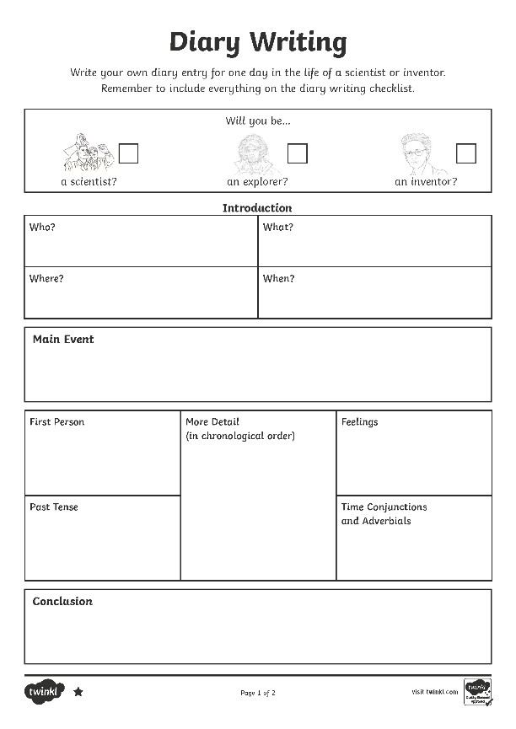
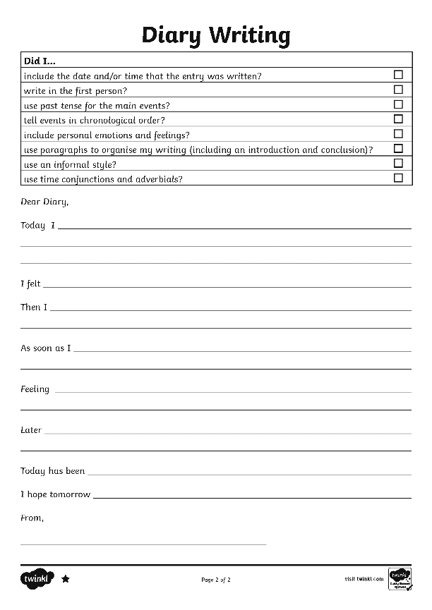
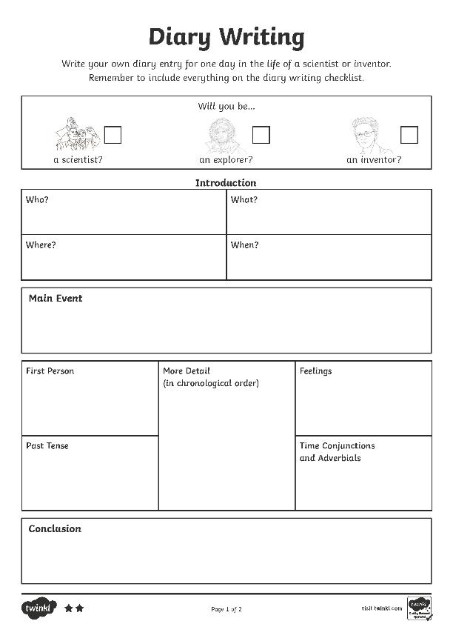
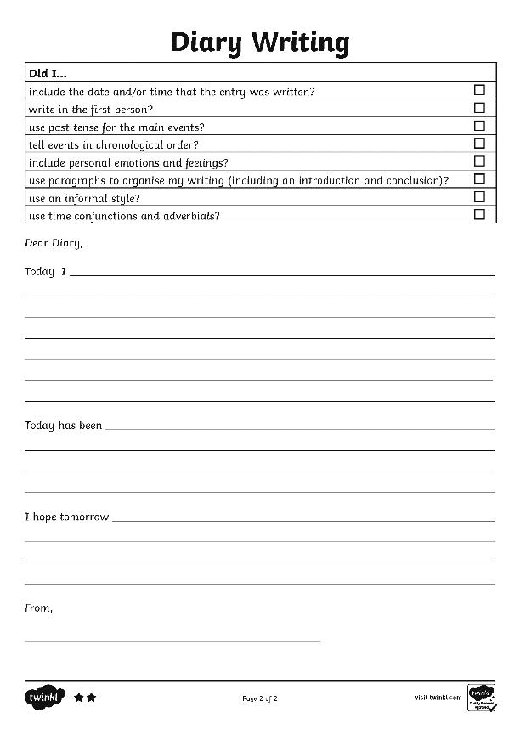
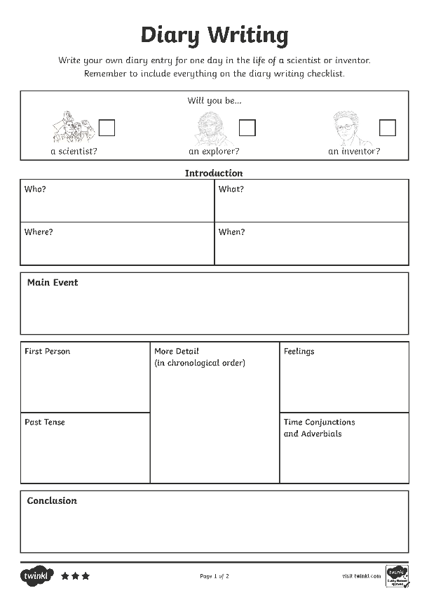
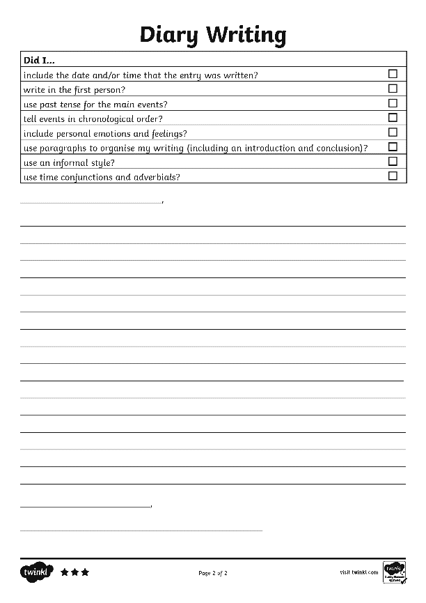
Find the features
Use the Differentiated Diary Examples to find the features of diaries using the Diary Writing Checklist to help you.

Slide 14
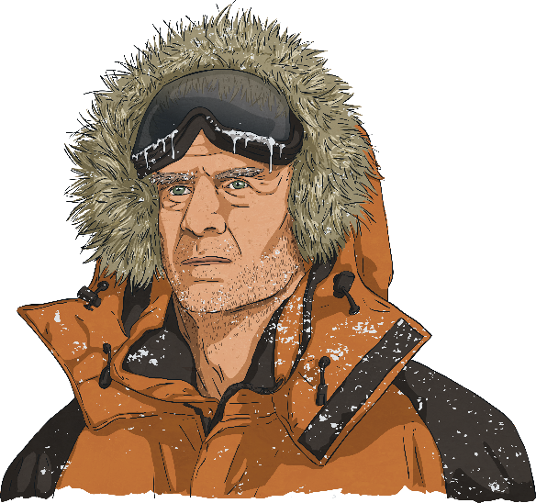
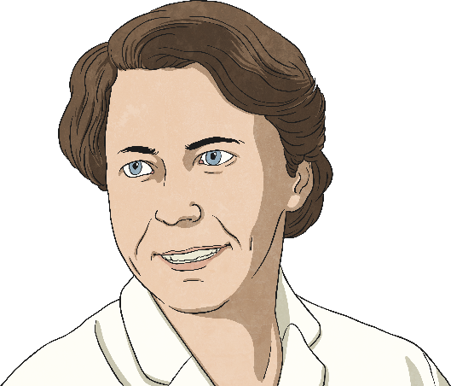
Write a diary
Now it’s your turn!
Using the Differentiated Diary Writing Activity Sheets, plan and write a diary from the point of view of someone who works with animals. Don't forget to include everything on the Diary Writing Checklist.
Will you be…
a scientist?
an explorer?
an inventor?

Slide 15
Diary Writing Check List
Can you remember all the things you need to do to write a fantastic diary entry?
Diary writing must...
include the date and/or time.
✓
write in the first person.
✓
use past tense for main events.
✓
include an introduction to set the scene.
✓
tell events in chronological order.
✓
include personal emotions and feelings.
✓
use time conjunctions and adverbials, e.g. ‘after that’, ‘before lunch’, ‘until sunset’.
✓

