Slide 1
RETRIEVAL
What is the ‘Why Not’?

Slide 2
VOCABULARY
What word means the same as ‘stale?
fresh ◻
cold ◻
damp ◻
old ◻

Slide 3
PREDICTION
What do you think will happen next?
Will anyone find him?

Slide 4
What is an adverb?
A word to tell us how, when, where or why a verb is done.
What is the difference between an adverb and an adverbial?
An adverbial is a phrase that tells us how, when, where or why a verb is done rather than using just one word.

Slide 5
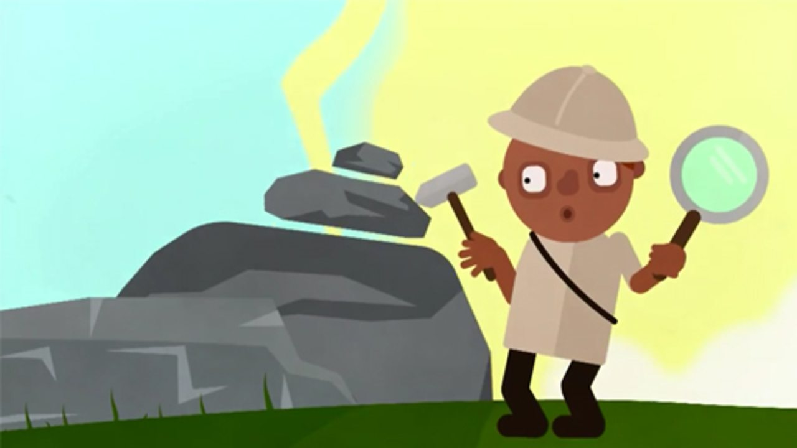
Now let’s read the story again and see if we can spot the use of adverbials.

Slide 6
Peeking over the edge,
How? When? Where?
Last year,
How? When? Where?

Slide 7
Eventually,
How? When? Where?
Dizzy from the stale vault air,
How? When? Where?
Inside,
How? When? Where?
With trembling hands,
How? When? Where?

Slide 8
Disappointed,
How? When? Where?
Crazy with panic,
How? When? Where?

Slide 10
Look at this picture from the story: How was John feeling? Where was John looking? When was it happening? Write some sentences about the picture using fronted adverbials Decide whether you are saying how, where or when. Remember the capital letter at the start. Remember the comma after the fronted adverbial.

