Slide 1
INFER / INTERPRET
Is Aunt Jane happy
with John?
How do you know?

Slide 2
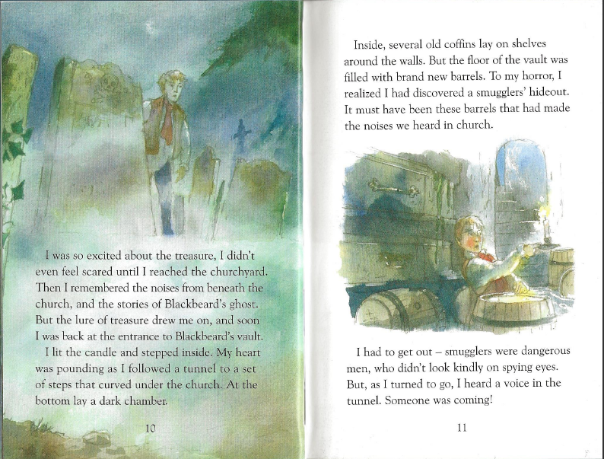
VOCABULARY
What word means the same as ‘lure’?
fear ◻
pull ◻
push ◻
thought ◻

Slide 3
PREDICTION
What do you think will happen next?
Who do you think is coming?

Slide 4
Let’s read the story again and see if we can spot the use of apostrophes …..

Slide 6
Apostrophes for
contraction or possession?
You’re
didn’t
Blackbeard’s
smugglers’

Slide 7
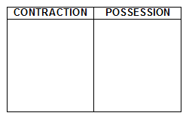
Draw this table: Put these words with apostrophes into the correct column it’s John’s wasn’t church’s we’d Moonfleet’s Aunt Jane’s can’t Now add 5 more of your own to each column.

