Slide 2
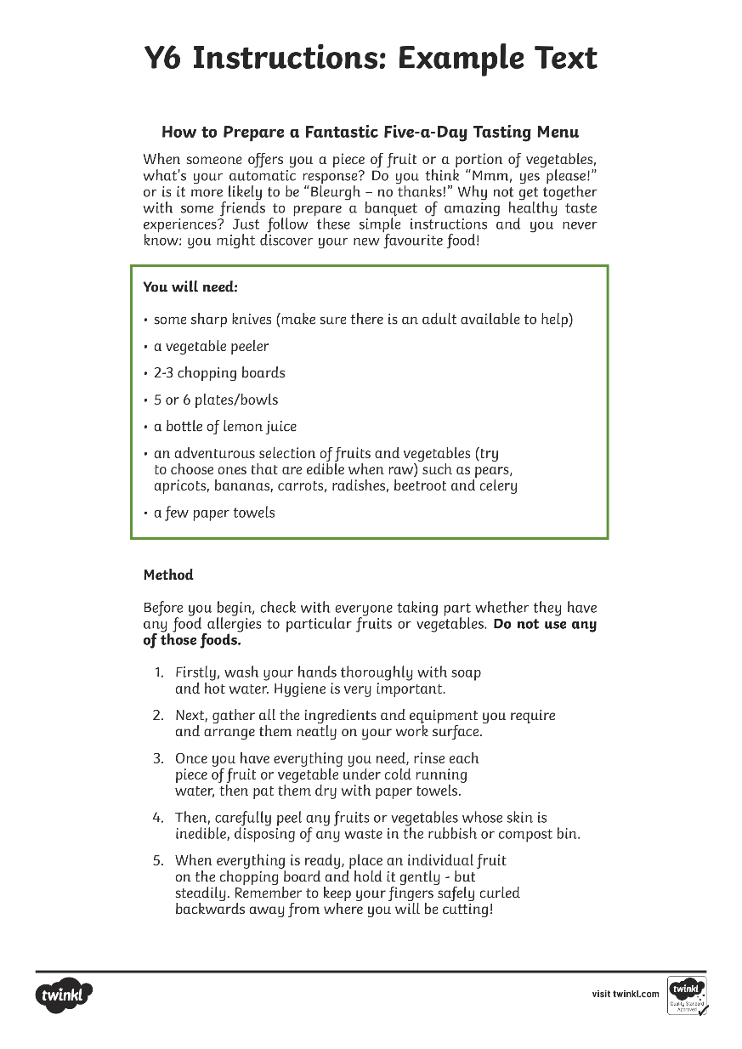
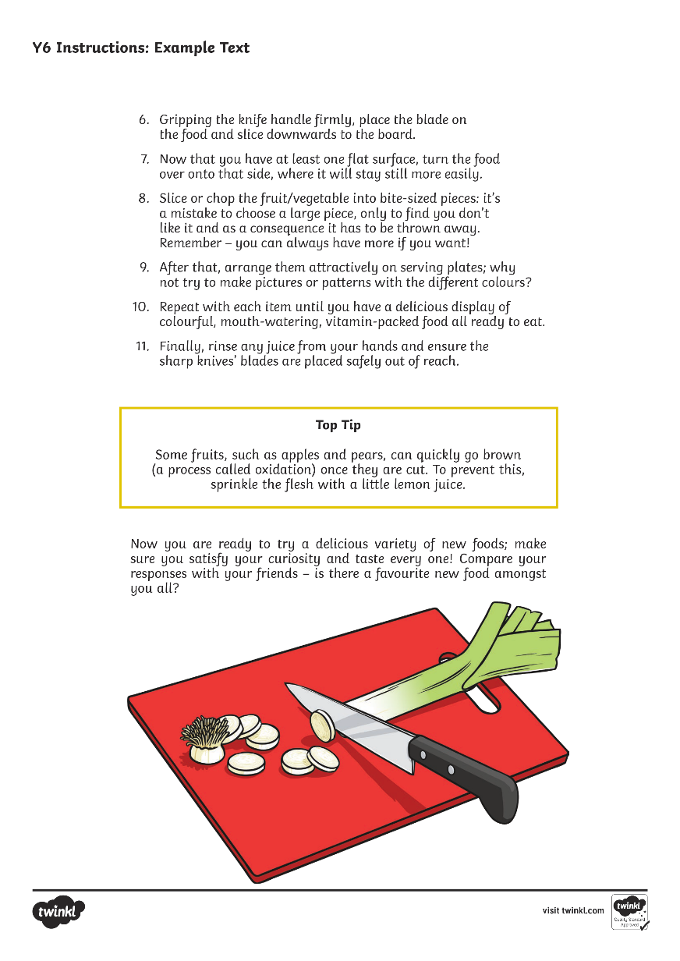

Slide 3
How to Prepare a Fantastic Five-a-Day Tasting Menu
When someone offers you a piece of fruit or a portion of vegetables, what’s your automatic response? Do you think “Mmm, yes please!” or is it more likely to be “Bleurgh – no thanks!” Why not get together with some friends to prepare a banquet of amazing, healthy taste experiences? Just follow these simple instructions and you never know: you might discover your new favourite food!
You will need:
some sharp knives (make sure there is an adult available to help)
a vegetable peeler
2-3 chopping boards
5 or 6 plates/bowls
a bottle of lemon juice
an adventurous selection of fruits and vegetables (try to choose ones that are edible when raw) such as pears, apricots, bananas, carrots, radishes, beetroot and celery
a few paper towels

Slide 4
Method
Before you begin, check with everyone taking part whether they have any food allergies to particular fruits or vegetables. Do not use any of those foods.
Firstly, wash your hands thoroughly with soap and hot water. Hygiene is very important.
Next, gather all the ingredients and equipment you require and arrange them neatly on your work surface.
Once you have everything you need, rinse each piece of fruit or vegetable under cold running water, then pat them dry with paper towels.
Then, carefully peel any fruits or vegetables whose skin is inedible, disposing of any waste in the rubbish or compost bin.
When everything is ready, place an individual fruit on the chopping board and hold it gently - but steadily. Remember to keep your fingers safely curled backwards away from where you will be cutting!

Slide 5
Gripping the knife handle firmly, place the blade on the food and slice downwards to the board.
Now that you have at least one flat surface, turn the food over onto that side, where it will stay still more easily.
Slice or chop the fruit/vegetable into bite-size pieces: it’s a mistake to choose a large piece, only to find you don’t like it and as a consequence it has to be thrown away. Remember – you can always have more if you want!
After that, arrange them attractively on serving plates; why not try to make pictures or patterns with the different colours?
Finally, rinse any juice from your hands and ensure the sharp knives’ blades are placed safely out of reach.
Repeat with each item until you have a delicious display of colourful, mouth-watering, vitamin-packed food all ready to eat.

Slide 6
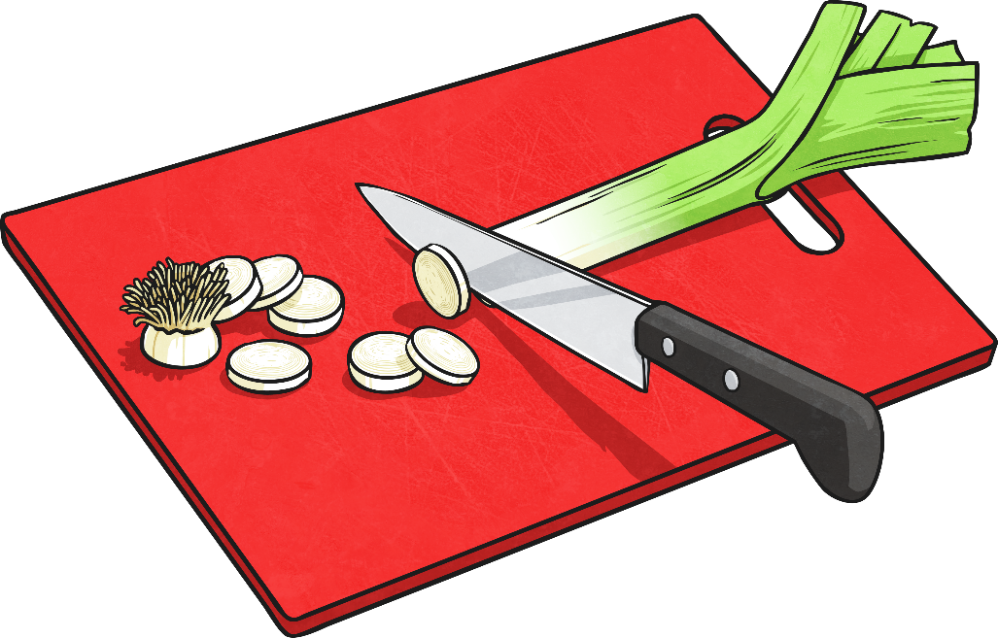
Top Tip
Some fruits, such as apples and pears, can quickly go brown
(a process called oxidation) once they are cut. To prevent this, sprinkle the flesh with a little lemon juice.
Now you are ready to try a delicious variety of new foods; make sure you satisfy your curiosity and taste every one! Compare your responses with your friends – is there a favourite new food amongst you all?

